Slide 1
TrackForce Final Presentation
Yongning Young Ma
EC 551 Fall 2023

Slide 2
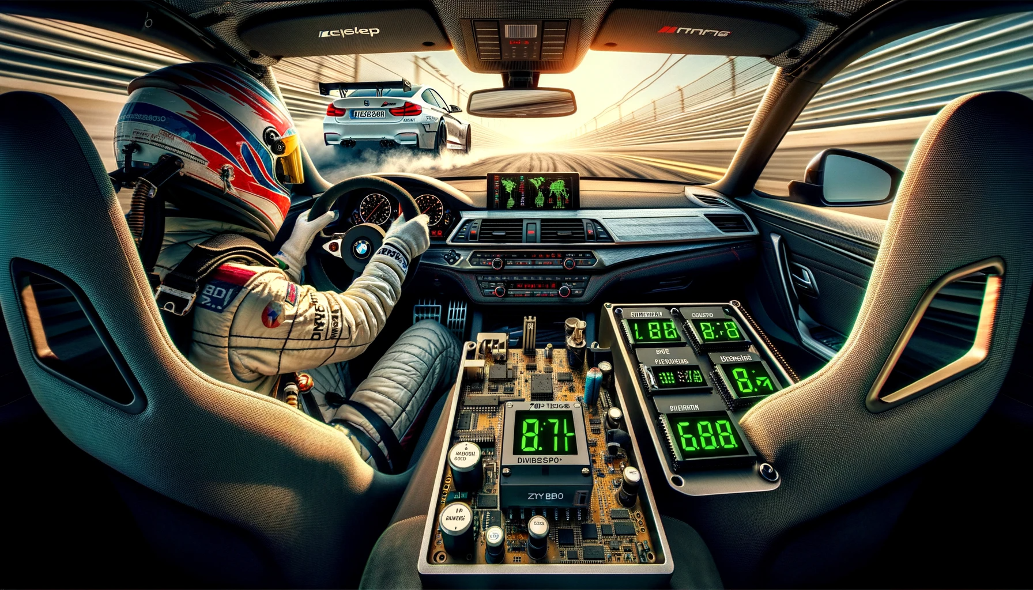
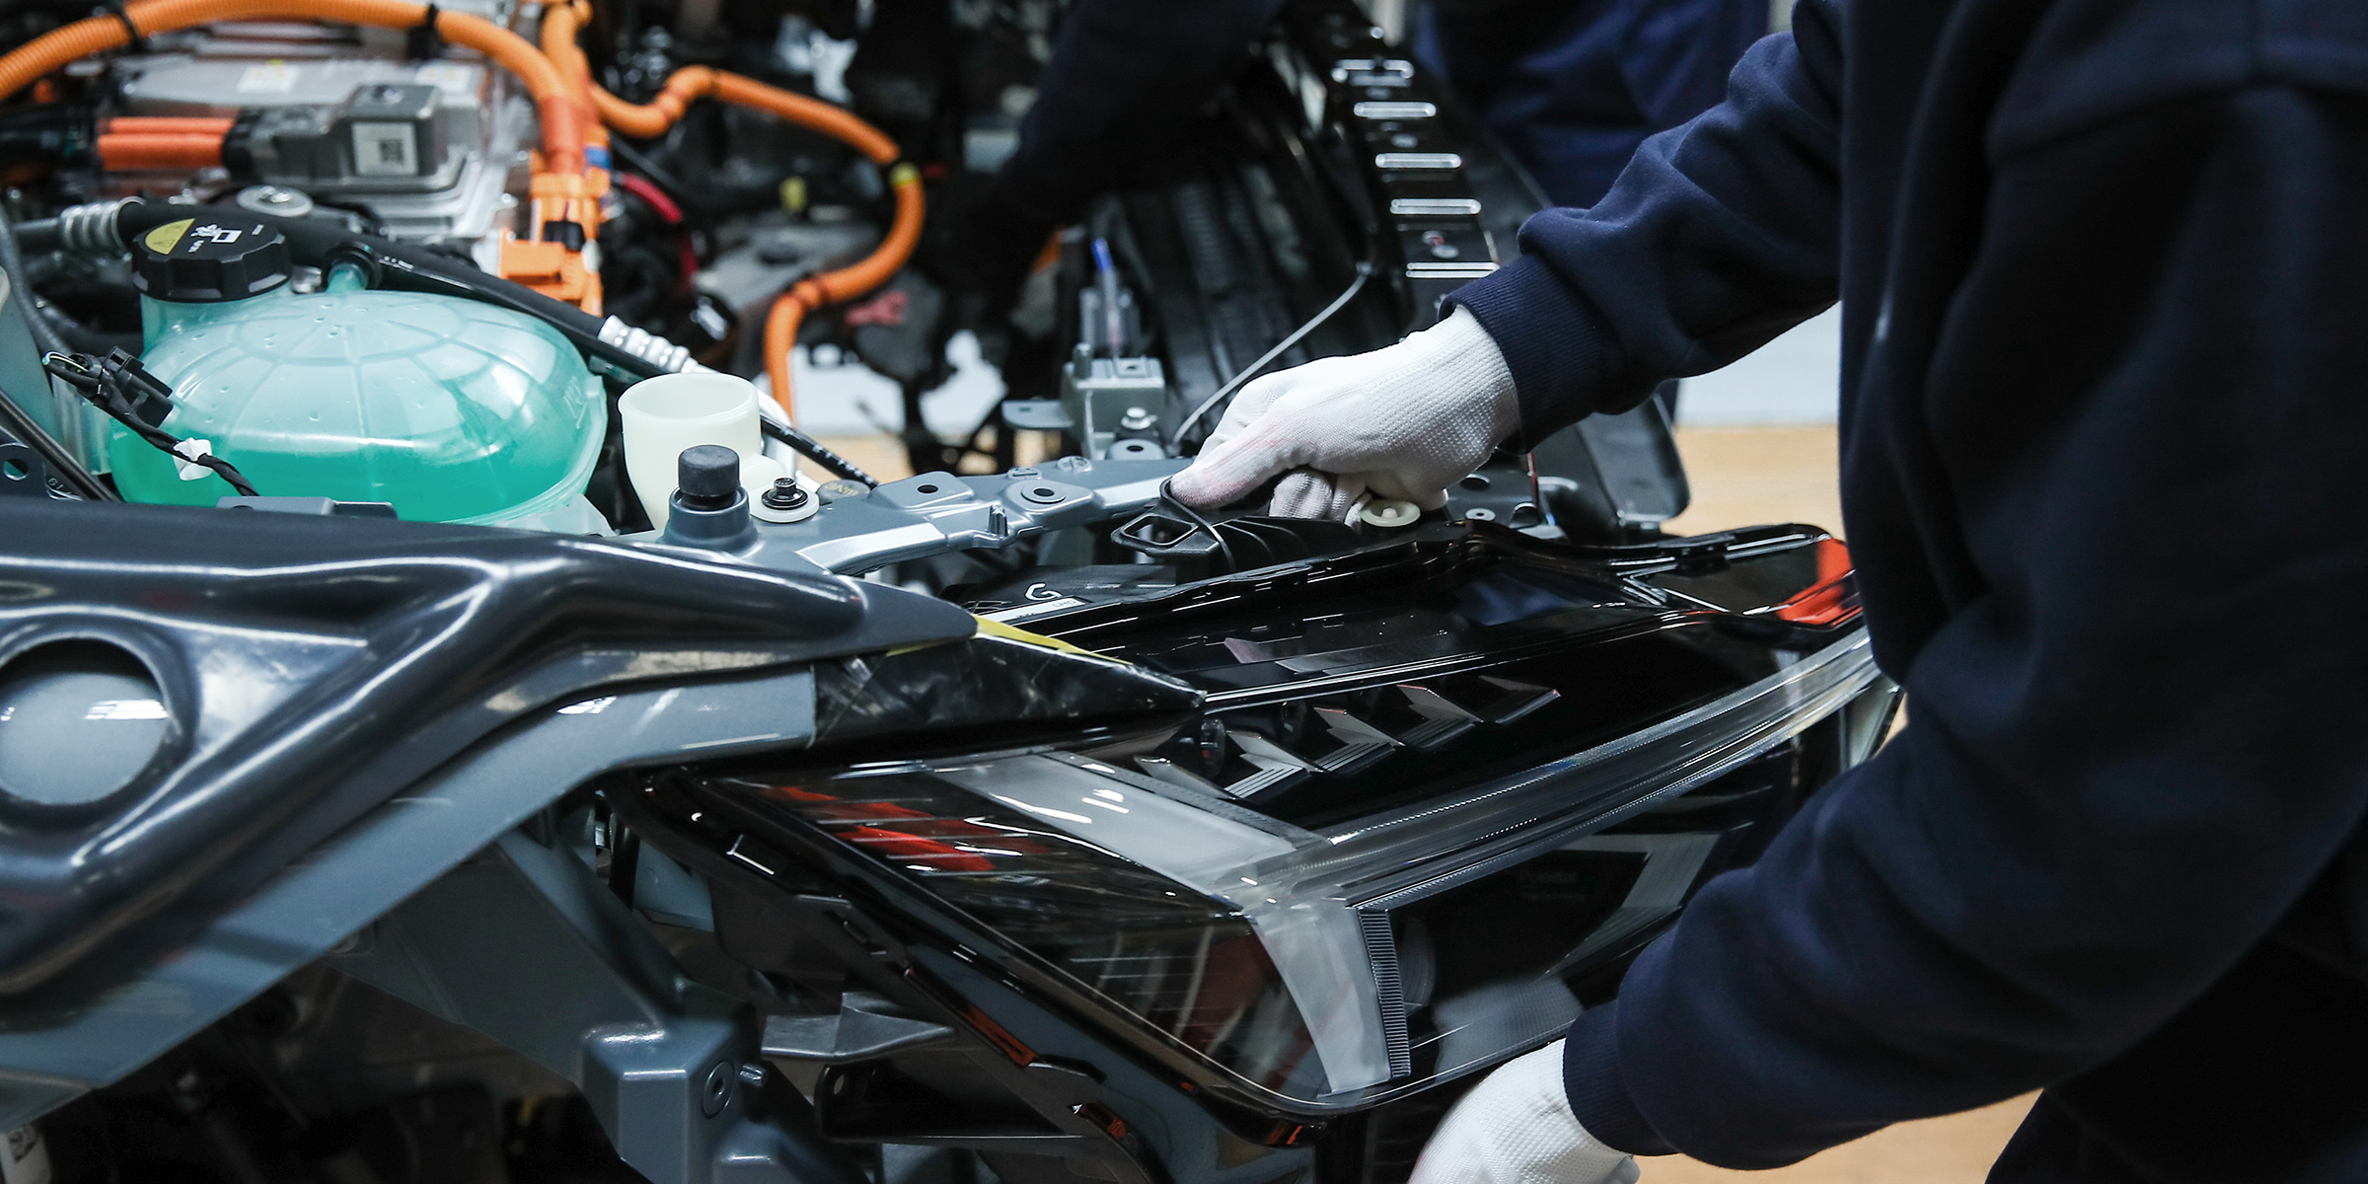
Project Goal
“A reference utility that can be used either in motorsport or automotive development purposes, down to the precise milliseconds.”

Slide 3
High Level Representation
Vehicle Dynamics
Indicates horizontal acceleration (G) pulled
Indicates dominant acceleration direction
Vehicle Speedometer
Indicates speed in kilometers per hour (km/h)

Slide 4
Specifications
Device should be self-contained
Good data reliability
Rolling-window filter to eliminate sensor artifacts.
High refresh rate to further increase accuracy.
Data outputs to 7-seg displays
HDMI dropped.

Slide 5
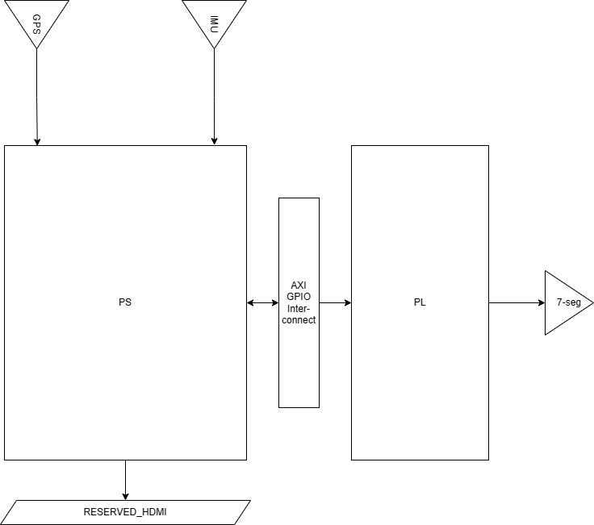
Functionality - Overview

Slide 6
Functionality - Overview
Device is partitioned between Processing System (PS) aka. embedded, and Programmable Logic (PL) aka. FPGA
Originally UART interface is to be in PL, but higher baud rate required a more robust implementation in PS
PS facilitates peripheral devices inputs, and can be expanded to output to other devices
PL performs decoding, filtering of data and output to 7Segs

Slide 7
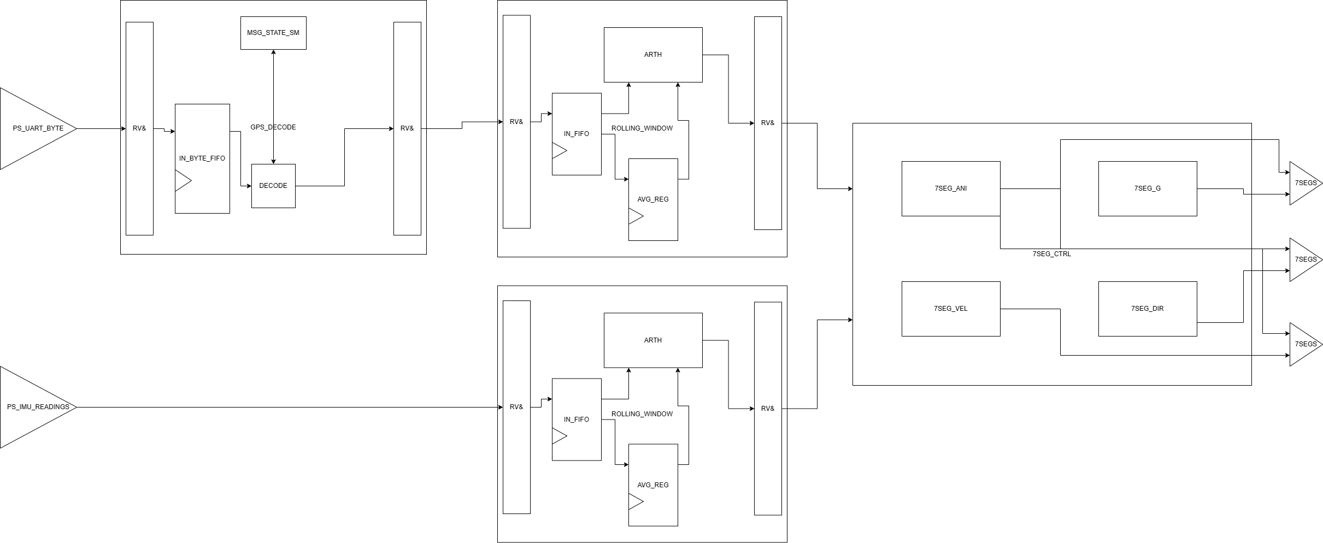
Functionality – Programmable Logic

Slide 8
Functionality – Programmable Logic
Datapath is RV& handshake and uses FIFO for pipeling
IMU data is straight forward, just a rolling window
GPS is the raw bytes from UART, and is decoded with a state machine; then it is filtered through rolling window
7Seg control decides if idle animation should be played or actual data

Slide 9
Functionality – Programmable Logic Cont.

Slide 10
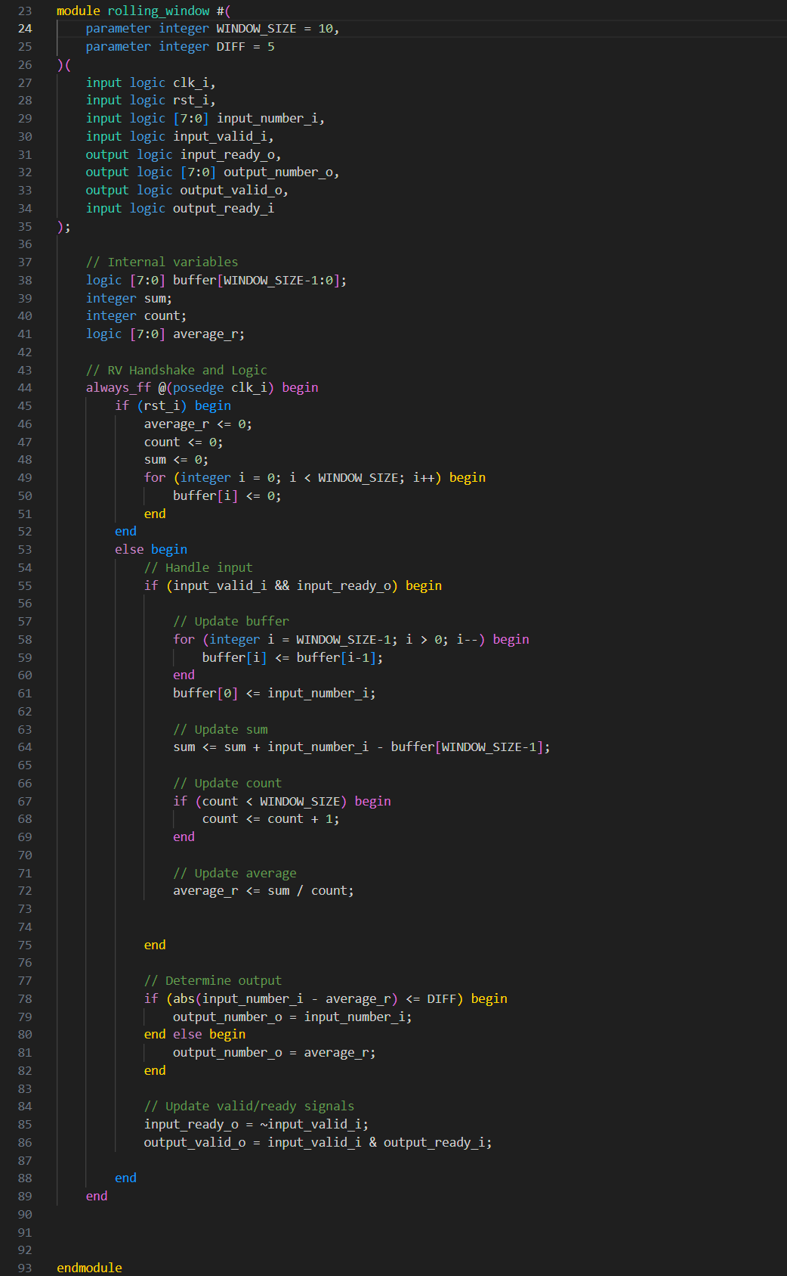
Functionality – Programmable Logic Cont.
Rolling window
Generic to any 8-bits long numbers
Keep track of the average of a parametrizable amount of recent inputs (adjusted to clock-speed)
If a data is out of bounds of a parametrizable difference, it is then replaced with the average

Slide 11
Functionality – Programmable Logic Cont.
GPS Decode
Looks at each byte that comes in (which is in ASCII). The GPS data is in that of a NMEA formatted sentences
“$” is the signifies start of new sentences, and it is followed by an identifier
“$GPVTG” contains the km/h data, at the 7th comma
Essentially, a nested (?) / parallel module of SMs while still adhering to RV&
SM waits for a valid identifier byte, or it stays idle.
If valid, parses and wait till the 7th comma to extract ASCII string of km/h
Convert to number with a hard-coded conversion

Slide 12
Functionality – Programmable Logic Cont. Verilog Example
All in text box ctrl+a to select all and paste to your fav editor!
// Macros for message ASCII
`define LF 10
`define CR 13
`define DOLLAR 36
`define COMMA 44
`define STAR 42
// Macro for message bits
`define CHAR_LENGTH 8
// gpsdecode
// ------------------------------
// Receives a NEMA message from the UART interface and decode it to signals
// used by other modules
// Only cares about GPVTG message
// Ready Valid& interface
//
// Inputs
// ------------------------------
// clk_i - Clock
// rst_i - Reset
// [7:0] data_i - ASCII char read from FIFO
// valid_i - Input message is valid
// ready_i - Next module is ready to receive data
//
// Outputs
// ------------------------------
//
// ready_o - Decoder is ready to receive a new message
// vkmh_o - Speed in km/h
//
// Example data from GPS
// $GPVTG,0.00,T,,M,0.00,N,0.00,K,N*32\r\n
//
// TalkerID, course, Reference, Course, Reference, Speed, Unit (knot), Speed, Unit (km/h), Mode, Checksum, CR, LF
// should get Speed before Unit (km/h)
module gpsdecode(
input [0:0] clk_i,
input [0:0] rst_i,
input [7 :0] data_i,
// data from FIFO is valid
input [0:0] valid_i,
// next module is ready to receive data
input [0:0] ready_i,
// data is ready to be read
output [0:0] ready_o,
output [0:0] valid_o,
output [7:0] vkmh_o
);
logic [0:0] ready_r;
logic [0:0] valid_r;
logic [7:0] vkmh_r;
//
// State machine
//
// 0 - Idle // Wait for $
// 1 - MsgID // Parse message ID, go to Continue if parsed as GPVTG. When msgidindex_r == 3 and msgidmatch_r == 1, stay in msgID and go to field when msgidindex_r == 5. Else go to ignore
// 2 - Continue // Parse message until 7th comma
// 3 - Speed // Parse Speed
// 4 - Done // Done parsing speed, set valid_o to 1.
typedef enum logic [2:0] {
IDLE,
MSGID,
FIELD,
IGNORE,
DONE
} state_t;
state_t state_r, state_n;
logic [7:0] msgidindex_r;
logic [7:0] commaindex_r;
logic [7:0] speedindex_r;
logic [0:0] msgidmatch_r;
always_ff @(posedge clk_i) begin
if (rst_i) begin
state_r <= IDLE;
end
else begin
state_r <= state_n;
end
end
// state transitions
always_comb begin
if (rst_i) begin
state_n = IDLE;
end
else begin
case (state_r)
IDLE: begin
if (data_i == "$") begin
state_n = MSGID;
end
else begin
state_n = IDLE;
end
end
MSGID: begin
if (msgidmatch_r == 1 && msgidindex_r == 5) begin
state_n = FIELD;
end
else if (msgidmatch_r == 0 && msgidindex_r > 3) begin
state_n = IGNORE;
end
else begin
state_n = MSGID;
end
end
FIELD: begin
if (speedindex_r == 3) begin
state_n = DONE;
end
else begin
state_n = FIELD;
end
end
IGNORE: begin
if (data_i == "$") begin
state_n = MSGID;
end
else begin
state_n = IGNORE;
end
end
DONE: begin
state_n = IDLE;
end
default : begin
state_n = IDLE;
end
endcase
end
end
// msgindex logic
// increment once whenever a new char is read (pulse of valid_i) when in msgid state
always_ff @(posedge clk_i) begin
if (rst_i) begin
msgidindex_r <= 0;
end
else begin
case (state_r)
IDLE: begin
msgidindex_r <= 0;
end
MSGID: begin
if (valid_i) begin
msgidindex_r <= msgidindex_r + 1;
end
else begin
msgidindex_r <= msgidindex_r;
end
end
FIELD: begin
msgidindex_r <= 0;
end
IGNORE: begin
msgidindex_r <= 0;
end
DONE: begin
msgidindex_r <= 0;
end
default : begin
msgidindex_r <= 0;
end
endcase
end
end
// msgid match logic
//
// check at index 3 if the char is V
// if it is, msgidmatch_r = 1
// else msgidmatch_r = 0
always_ff @(posedge clk_i) begin
if (rst_i) begin
msgidmatch_r <= 0;
end
else begin
case (state_r)
IDLE: begin
msgidmatch_r <= 0;
end
MSGID: begin
if (msgidindex_r == 3) begin
if (data_i == "V") begin
msgidmatch_r <= 1;
end
else begin
msgidmatch_r <= msgidmatch_r;
end
end
else begin
msgidmatch_r <= msgidmatch_r;
end
end
FIELD: begin
msgidmatch_r <= 0;
end
IGNORE: begin
msgidmatch_r <= 0;
end
DONE: begin
msgidmatch_r <= 0;
end
default : begin
msgidmatch_r <= 0;
end
endcase
end
end
// commaindex logic
always_ff @(posedge clk_i) begin
if (rst_i) begin
commaindex_r <= 0;
end
else begin
case (state_r)
IDLE: begin
commaindex_r <= 0;
end
MSGID: begin
commaindex_r <= 0;
end
FIELD: begin
if (valid_i) begin
if (data_i == ",")
commaindex_r <= commaindex_r + 1;
end
else begin
commaindex_r <= commaindex_r;
end
end
IGNORE: begin
commaindex_r <= 0;
end
DONE: begin
commaindex_r <= 0;
end
default : begin
commaindex_r <= 0;
end
endcase
end
end
// speedindex logic
always_ff @(posedge clk_i) begin
if (rst_i) begin
speedindex_r <= 0;
end
else begin
case (state_r)
IDLE: begin
speedindex_r <= 0;
end
MSGID: begin
speedindex_r <= 0;
end
FIELD: begin
if (valid_i) begin
if (commaindex_r == 7) begin
speedindex_r <= speedindex_r + 1;
end
end
else begin
speedindex_r <= speedindex_r;
end
end
IGNORE: begin
speedindex_r <= 0;
end
DONE: begin
speedindex_r <= 0;
end
default : begin
speedindex_r <= 0;
end
endcase
end
end
// speed logic
logic [7:0] speed_r;
always_ff @(posedge clk_i) begin
if (rst_i) begin
speed_r <= 0;
end
else begin
case (state_r)
IDLE: begin
speed_r <= 0;
end
MSGID: begin
speed_r <= 0;
end
FIELD: begin
if (valid_i) begin
if (commaindex_r == 7) begin
if (speedindex_r == 0) begin
case (data_i)
"0" : speed_r <= 0;
"1" : speed_r <= 10;
"2" : speed_r <= 20;
"3" : speed_r <= 30;
"4" : speed_r <= 40;
"5" : speed_r <= 50;
"6" : speed_r <= 60;
"7" : speed_r <= 70;
"8" : speed_r <= 80;
"9" : speed_r <= 90;
default: speed_r <= 0;
endcase
end
else if (speedindex_r == 1) begin
case (data_i)
"0" : speed_r <= speed_r + 0;
"1" : speed_r <= speed_r + 1;
"2" : speed_r <= speed_r + 2;
"3" : speed_r <= speed_r + 3;
"4" : speed_r <= speed_r + 4;
"5" : speed_r <= speed_r + 5;
"6" : speed_r <= speed_r + 6;
"7" : speed_r <= speed_r + 7;
"8" : speed_r <= speed_r + 8;
"9" : speed_r <= speed_r + 9;
// this should handle empty msg
default: speed_r <= speed_r + 0;
endcase
end
end
end
else begin
speed_r <= speed_r;
end
end
IGNORE: begin
speed_r <= 0;
end
DONE: begin
speed_r <= 0;
end
default : begin
speed_r <= 0;
end
endcase
end
end
//
always_ff @(posedge clk_i) begin
if (rst_i) begin
ready_r <= 0;
valid_r <= 0;
end
else begin
case (state_r)
IDLE: begin
ready_r <= 1;
valid_r <= 0;
end
MSGID: begin
ready_r <= 1;
valid_r <= 0;
end
FIELD: begin
if (speedindex_r == 3) begin
ready_r <= 0;
valid_r <= 1;
end
else begin
ready_r <= 1;
valid_r <= 0;
end
end
IGNORE: begin
ready_r <= 1;
valid_r <= 0;
end
DONE: begin
ready_r <= 0;
valid_r <= 0;
end
default : begin
ready_r <= 0;
valid_r <= 0;
end
endcase
end
end
// outputs
assign ready_o = ready_r;
assign valid_o = valid_r;
assign vkmh_r = speed_r;
assign vkmh_o = vkmh_r;
endmodule

Slide 13
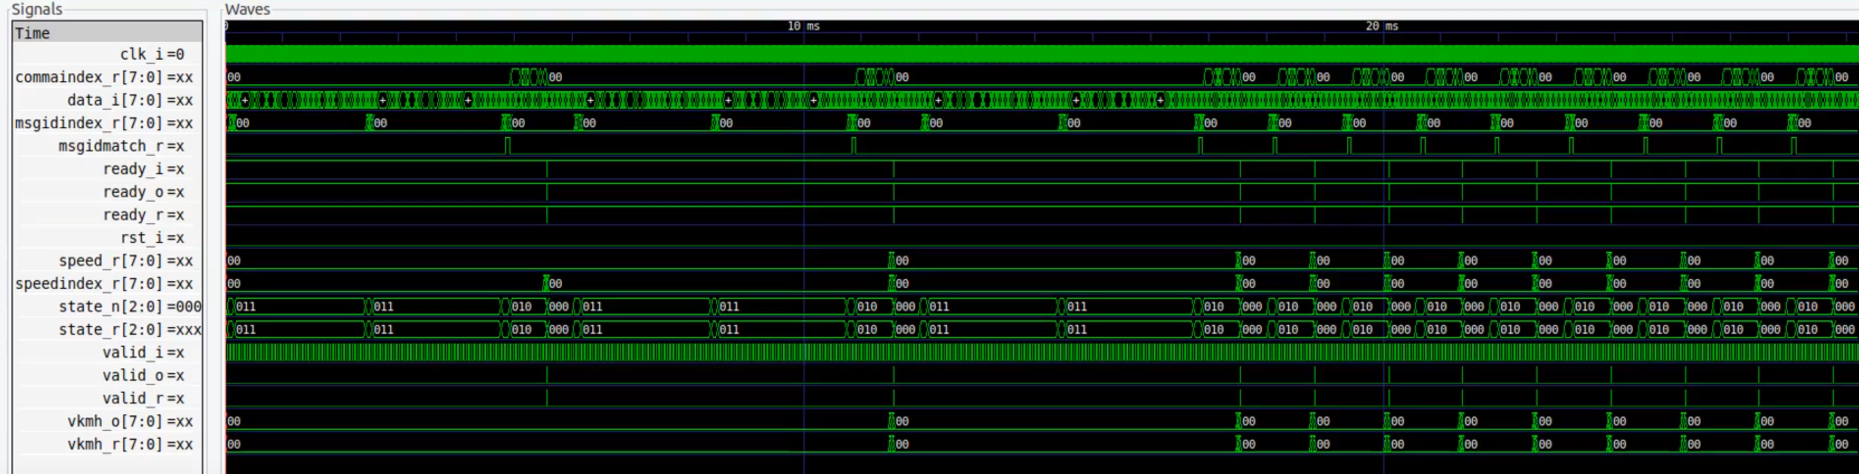
Functionality – Programmable Logic Cont. Verilog Example

Slide 14

Functionality – Programmable Logic Cont. Verilog Example
[Young if you are looking at this you either forgot to embed the pdf or powerpoint didn’t save it right]

Slide 15
Functionality – Programmable Logic Cont.

Slide 16
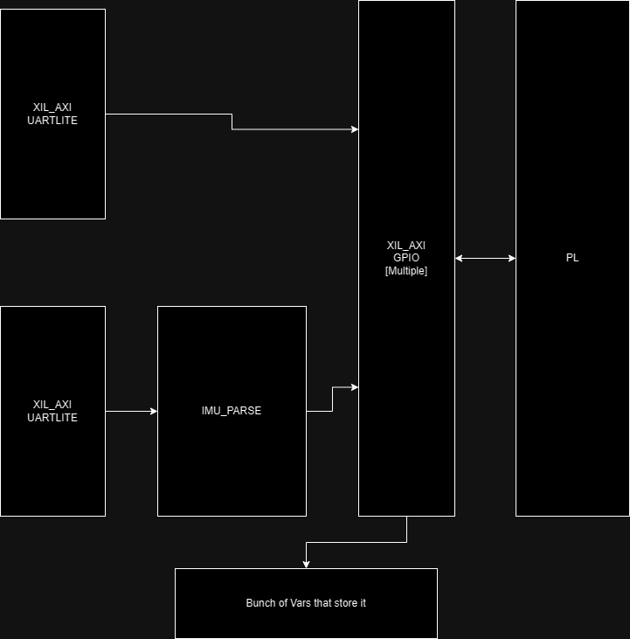
Functionality – Processing System

Slide 17
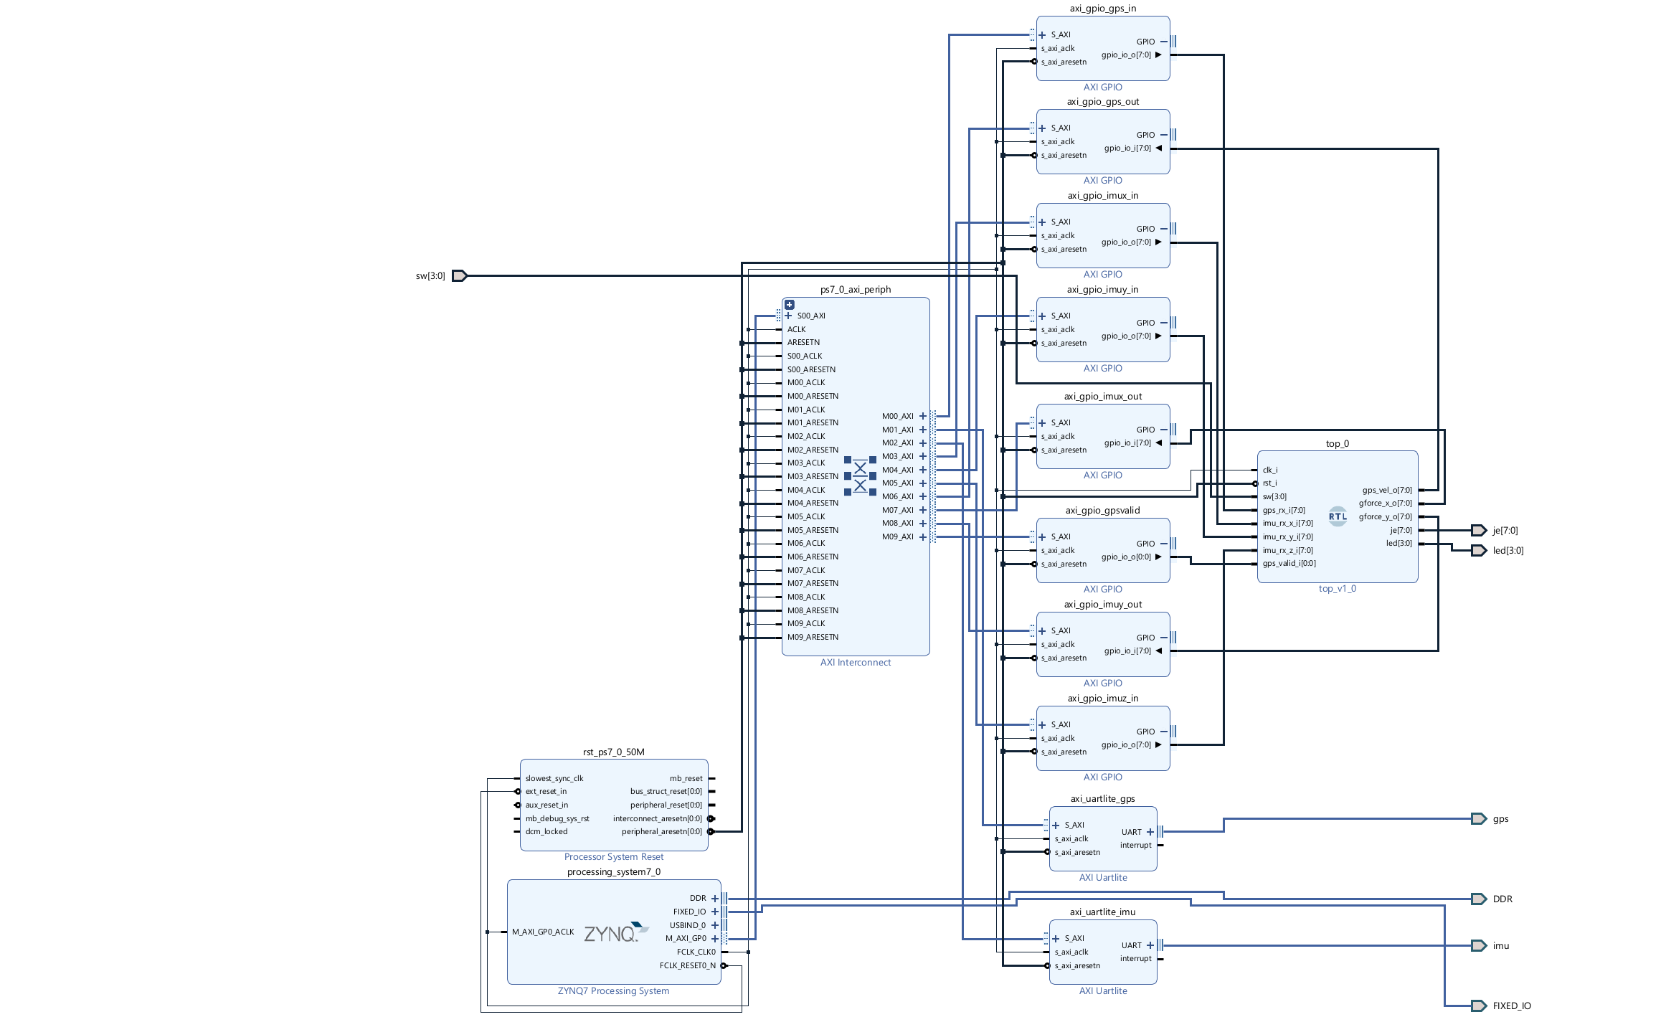
System Block Diagram – Design Tool

Slide 18
Performance Metrics
PL Clock @ 50MHz
PS Clock @ 133MHz
GPS Update @ 10Hz
IMU Refresh @ ? (TBD based on PS implementation)

Slide 19
Successes
SystemVerilog enabled relatively rapid new RTL component developments
RTL portion of the project handles the most time-sensitive processing: critical in application that require precision
(Not so on a project level) But this is my first PS/PL project and I (mostly) pulled it through

Slide 20
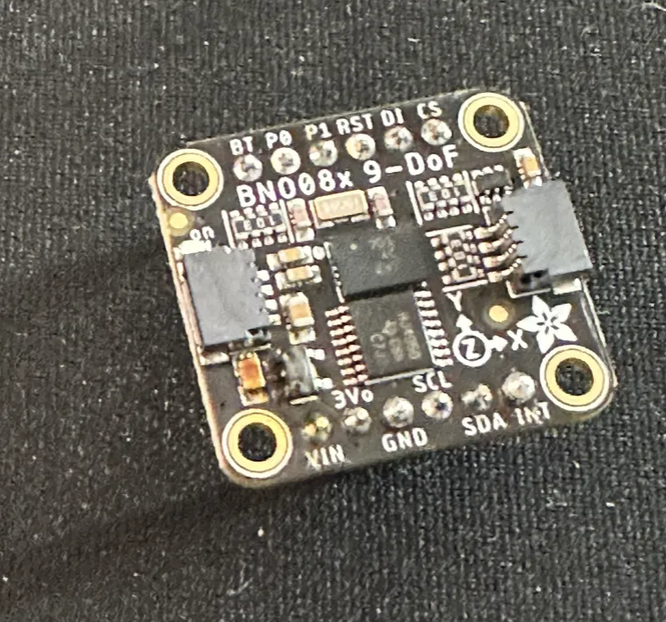
Failures
Soloing is lonely!
Was not so concrete on the design tools revision until mid-semester. (If you seen the piazza post you know)
Dropped Kalman Filter and replaced with rolling-window
Not the worse compromise: rolling-window achieves mostly the same function of getting rid of sensor artifacts
Issue with clocks. Either:
One clock source, but the Kalman Filter cannot run fast enough for the UARTs to achieve desired baud rate
Two different clock source makes everything out of sync
Underestimate Vitis learning curve
Most of PS development is still underway
Dropped HDMI out, data storage due to time constraint
Lots of peripheral issues
For quite a while there was a power budget issue
Shot 31V AC instead of 3.1V DC through an IMU and caused delay
IMU integration on the PS part is still in progress

Slide 21
References
https://polestartechhub.com/categories/service-parts-literature

